Slide 1

Wicklow Sports & Recreation Partnership
End of Year Review 2021
9th of December 2021
Aisling Hubbard, Coordinator,
Wicklow Sports & Recreation Partnership

Slide 2

Overview of Wicklow Sports & Recreation Partnership
Sub-Committees
Finance
Cllr. Gerry Walsh
Mai Quaid
Dr. Emer O'Leary
Governance
Eamonn Whelan
Charlie Batt
Brian Dunne
Phyllis Farrell
App Subcommittee
Eamonn Whelan
Mai Quaid
Gerry Walsh
Emer O'Leary
Carol Coad
Brian Dunne
Audit & Risk
Eamonn Whelan
Charlie Batt
Fionnuala Curry
Sports Grants
Paula Prunty
Fionnuala Curry
Phyllis Farrell
Emer O'Leary
Committee Structure:
Eamonn Whelan (Chairperson) | Leisure Service Providers
Charlie Batt (Vice Chairperson) | KWETB
Michael Nicholson | Director of Service, Wicklow Co. Co.
Fionnuala Curry | Children & Young People's Services Committee
Carol Coad | RRO - Co Wicklow Partnership
Brian Dunne | Wicklow Uplands Council
Cllr. Gerry Walsh | Wicklow Co Cllr
Cllr. Paul O'Brien | Wicklow Co Cllr
Mai Quaid | County Wicklow Older Persons Council
Phyllis Farrell | PPN
Dr. Emer O'Leary | HSE
Garda Niall Kennedy | Gardai
Paula Prunty | National Governing Body Rep - LGFA
Lorraine Dunne | Healthy Ireland Co-ordinator

Slide 3
Overview of Wicklow Sports & Recreation Partnership
Committee WSRC | 28/01/21 | 25/03/2021 | 27/05/2021 | 29/07/2021 | 30/09/2021 | Governance 02/09/2021
Eamonn Whelan | Present | Present | Present | Apologies | Present | Present
Charlie Batt | Present | Present | Apologies | Present | Present | Present
Michael Nicholson | Apologies | Present | Present | Present | Apologies | Present
Fionnuala Curry | Present | Present | Present | Present | Present | Present
Carol Coad | Apologies | Present | Apologies | Present | Apologies | Apologies
Brian Dunne | Present | Present | Apologies | Present | Present | Present
Cllr. Gerry Walsh | Present | Apologies | Present | Present | Apologies | Present
Cllr. Paul O'Brien | Apologies | Apologies | Apologies | Present | Present | Present
Mai Quaid | Present | Present | Present | Present | Present | Present
Phyllis Farrell | Present | Present | Present | Present | Present | Present
Dr. Emer O'Leary | Present | Present | Present | Present | Present | Present
Paula Prunty | Present | Apologies | Present | Present | Present | Apologies
Lorraine Dunne | Apologies | Present | Apologies | Present | Present | Present
Niall Kennedy | Present | Present | Present | Apologies | Present | Present

Slide 4
Staffing Structure Wicklow Sports & Recreation Partnership
Wicklow County Council
Administrator WSRP
Sandra Dunne
Coordinator Wicklow Sports & Recreation Partnership
Aisling Hubbard
Community Sports Development Officer
(Vacant)
Community Sports Development Officer
Denise O’Shea
Committee of Wicklow Sports & Recreation Partnership
Sport Ireland
Sports Inclusion Development Officer
Clara Jenkinson
Strategic Promotions Officer
(Vacant)
Healthy Wicklow Coordinator
Lorraine Dunne

Slide 5
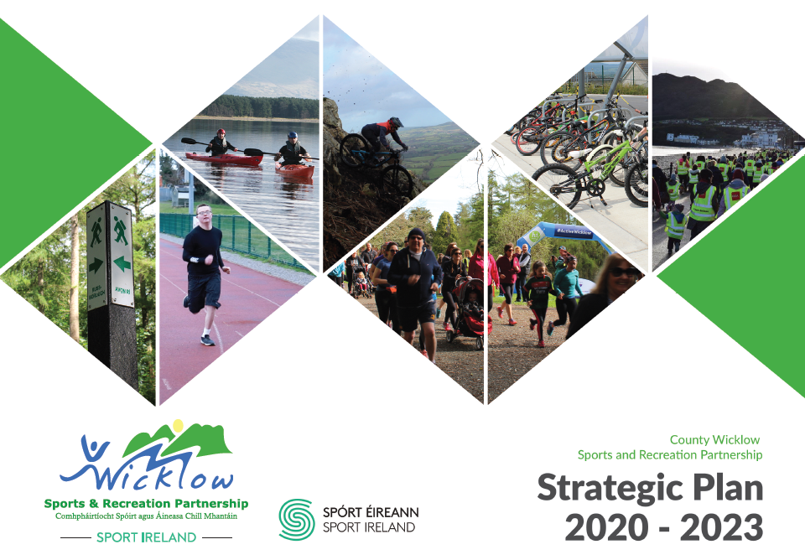
Strategic Plan 2020 - 2023
‘More people enjoying taking part’
Encouraging fun in Sports and Physical activities
Inspire participation amongst the less active
Supporting providers of sports and physical activities

Slide 6
Strategic Plan 2020 – 2023
Action Areas 1-4
Action Area 1 - Diverse Opportunities
  Actively support the different needs of physical activity participants
  Identify gaps and drive actions to provide pathways
  Support clubs and communities to provide inclusive, diverse and quality physical activity opportunities
  Inclusion, targeting disability, ethnic minorities, women & girls
Action Area 2 – Good Places and Great People
  Advocate for, encourage and actively support those who develop, improve and manage recreational sports & physical activity facilities
  Provide, organise and support training and education opportunities.
  Encourage and support educators to instil the value and provide the opportunity of sports and physical activity
Action Area 3 – Research and Communications
  Capture & analyse participation data from our programmes
  Highlight the insights from our Research and the Research of others
  Devise an annual communication plan that will increase awareness of available activities, promote those who provide participation opportunities and raise the visibility and awareness of the WSRP
  Develop partnerships with stakeholders in Ireland and Europe where appropriate
Action Area 4 – Standards and Resources
  Support sports and physical activity organisations to adhere to proper governance, safety and administration standards within their area of expertise.
  Be transparent in what we do and how we do it by operating high levels of governance and by adhering to formal operating procedures across all areas of responsibility
  Pursue the use of available resources as effectively as possible

Slide 7
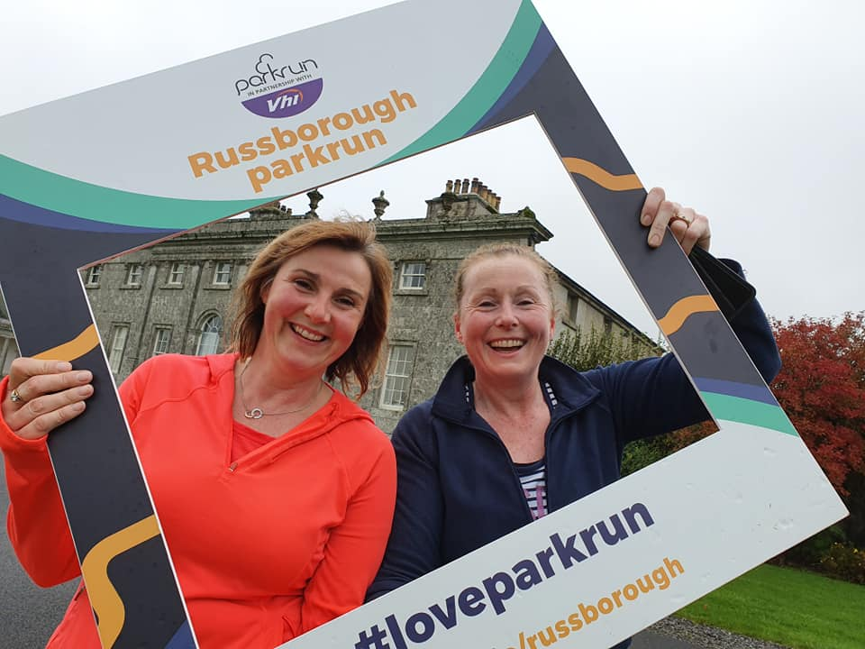
Action Area1
Diverse Opportunities
Action Area 1 - Diverse Opportunities
  Actively support the different needs of physical activity participants
  Identify gaps and drive actions to provide pathways
  Support clubs and communities to provide inclusive, diverse and quality physical activity opportunities
  Inclusion, targeting disability,
  ethnic minorities, women & girls

Slide 8

Action Area1
Diverse Opportunities
Online Physical Activity Programmes
  Inclusive online physical activity
    Sessions delivered to Children, Teenagers and Adults with a physical or intellectual disability or child and adolescent mental health (CAMH) challenges. This was done in collaboration with a range of organisations including, Lucena St John of God CAMH, Marino Special School, Newcourt Special School, St Catherine’s and St Augustine’s Special Schools, Sunbeam House Services, Autism Initiatives.
    Online Easter Inclusive camp. The Easter camp was shortlisted for Chambers Ireland Excellence in Local Government Awards in the Disability Services Provision category
      Parents quote:“I didn't want the weekend to go without expressing our thanks for those lovely classes for Lana during the Easter holidays. It was a real help and a focus in the day for Lana and for me. She was so chilled after them…. Can you please pass on our thanks to all the girls that did the classes? What goes around, comes around and I certainly hope the goodness you put out in the world comes back to you and everybody who enabled these sessions for our kids.”
      Sustainability: As a result of these collaborations, Lucena clinic have formed a working group to support teenagers in sporting and creative activities when they progress from their services. Wicklow Sports & Recreation are part of this working group, along with CYPSC, ‘AsIam’, ADHD Ireland, Foreoige and HSE. The overall outcome is that these teenagers and young people will then hopefully attend activities outside of the organisation they are involved with and continue to participate in sport, physical activity and creative endeavours.
    CYPSC Collaboration for KeepWell Campaign, online classes and Sports Packs
      An interagency collaboration with CYPSC, Wicklow County Childcare Committee (WCCC), Healthy Wicklow, Wicklow Sports & Recreation Partnership, Bray Sports Promotion Unit, Respond, among others. This activity was targeted at disadvantaged families around County Wicklow who engaged with family support services. Online Zoom classes in Yoga and Dance were provided, from mid January to March. Also as part of this campaign funded by the Government initiative KeepWell, Wicklow Sports & Recreation Partnership created 46 Sports Pack with a variety of sports equipment tailored to each families demographic.

Slide 9
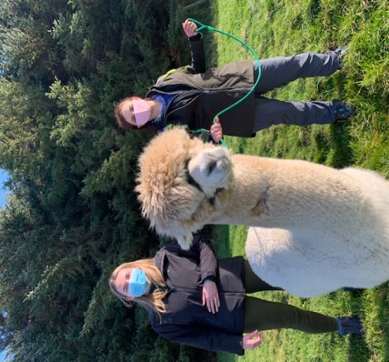
Action Area1
Diverse Opportunities
Inclusive Step Challenge
  Several groups around County Wicklow including The Pod Wicklow, Sunbeam House Services and Lucena Clinics Wicklow and Bray, took part in a 4 week step challenge. Healthy Ireland provided all the participants with a step counter and a Wicklow Sports & Recreation Partnership t-shirt at the end of the programme. The inter agency competitiveness created a great motive for participation.
Keepwell Sensory Packs
  As part of the collaboration above, 34 Sensory bags were distributed to families with a child with a disability or autism diagnosis. A variety of sensory balls, and tailored sports equipment was included.
Dance for Social Prescribing Day
  In collaboration with Bray Area Partnership and County Wicklow Partnership, a Free Dance class was organised to celebrate Social Prescribing Day on 18th March.
Dance programme with Rathmore residents (Direct Provision Centre).
  A Dance programme was delivered to residents of Rathmore, Ashford.
  3 groups of different ages, through different dance routines during August over 2 training days.
  This was in collaboration with Wicklow Arts Office, funding 50% of the programme.
Lucena Clinic – Alpaca Walking Programme
12 young clients of Lucena clinic who present for mental health
and/or with ASD participated in a 4 week programme of Alpaca walking
in Newtownmountkennedy during May and June. Co-funded with CYPSC,
this programme was hugely successful when first piloted in 2019 by Lucena.

Slide 10
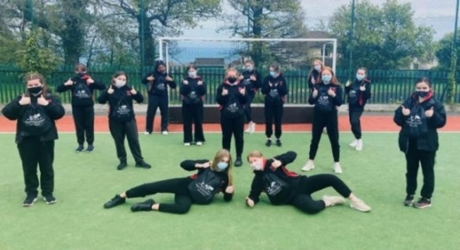
Action Area1
Diverse Opportunities
Online Physical Activity Programmes
  Couch to…3/5K
    Online Couch to 3K
      January had 121 participants
      35 first years from Loreto Bray completed
      ‘Recliner to 3K’ with Blessington Womens Shed had 57 participants.
    Online Couch to 5K
      January 6 week programme had 161 participants
      March 6 week programme had 47 participants (including those who graduated up from the Couch to 3K
      November 6 week programme has 50 participants and this will finish with a 5K Santa Dash in December
    Online Build to 10K
      Following feedback we ran our first ever 6 week 10K programme with 27 participants.

Slide 11
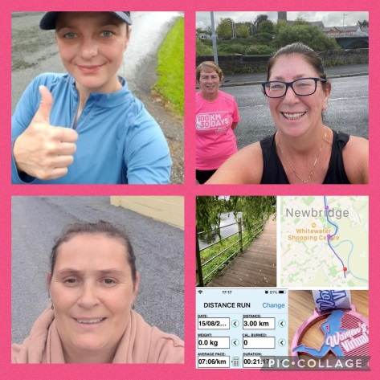
Action Area1
Diverse Opportunities
Online Physical Activity Programmes
  Intro to Online Pregnancy Yoga
    A four week Online Intro to Pregnancy Yoga. This programme was suitable for 12+ weeks pregnant, started Tuesday 16th March
    Our second four week pregnancy yoga programme started Monday 17th. 15 women took part in this programme.
  Intermediate Yoga Programme
    This was a 6 week online programme aimed at the general population. 16 people took part.
    Intro to Online Pregnancy Yoga 17th.
  GAA Healthy Clubs
    24th March an Online Yoga class for anyone who is a member of a GAA club that is part of the Healthy Club initiative. There was a huge demand, so we offered a 4 week course for club members. 91 people took part.
  Online Pilates
    This programme was delivered twice a week in partnership with HD Fitness,
    Blessington. From the 5th of April. 57 participants took part
  Buggyfit
    A virtual Buggyfit programme started Tuesday 16th March for six weeks
    with 17 people in attendance.
  Online Men on the Move
    8 week exercise programme targeting men who were not physically active.
    This programme took place via zoom, twice a week.
    A total of eight men took part and on completion will receive #ActiveWicklow t-shirt.

Slide 12
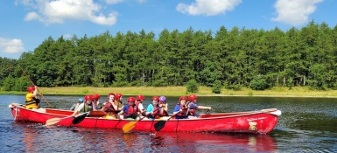
Action Area1-Diverse Opportunities
Camps
Blessington Outdoor Disability Inclusion Camp
  Blessington Outdoor Disability Inclusion Camp – 2 days in July & 2 days in August.
  A hugely successful Outdoor camp, giving the opportunity for 35 children and teenagers with an Intellectual Disability, Downs Syndrome and on the Autistic Spectrum to participate in this land and water based fun activities over 2 days for both camps. With Volunteers from Blessington GAA & DLR SIDO, community drive from the Blessington Access Group, Blessington District Forum and Blessington Autism Mums FB page this camp was full within a few days of spreading the news. Split into 2 groups of 10 for 3 hours each day.
Feedback from parents has been fantastic.
Also new connections have been made with the parents and they are looking for
support to set up a structured support group to
enable them to run similar programmes for their Blessington Children & Teenagers with ASD/DS/ID. One of the feedback messages below:
“Lovely meeting you and thank you so much for the last
two days. Daniel loved it and had a great time. It was so
great that we had the opportunity for our children
to have camp and feel like everyone else.
I also met some great Moms, lovely to have a new network.”

Slide 13
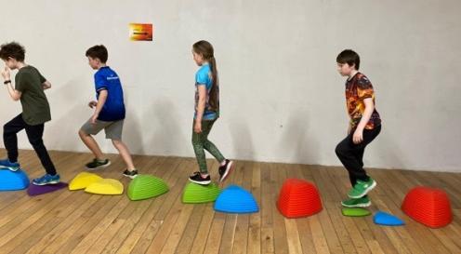
Action Area1-Diverse Opportunities
Camps
Triple A – 3 Day Camp – August 2021
  Triple A is a support group for children with Autism, Aspergers or ADHD and their families. The camp took place in Eire Og Greystones with 24 children in 2 groups. Over the 3 days the groups enjoyed lots of fun activities with two tutors provided by Wicklow Sports & Recreation

Slide 14
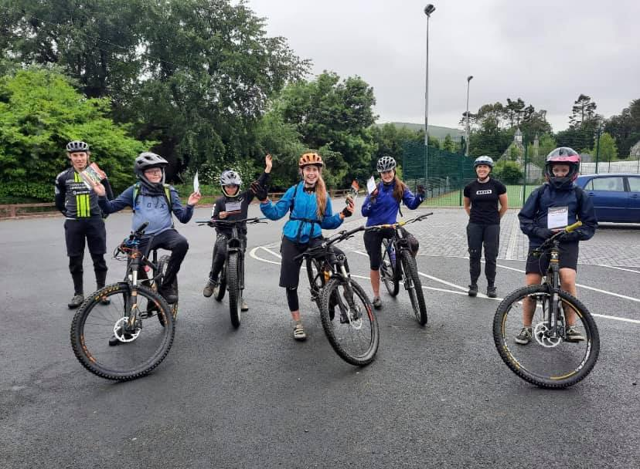
Action Area1-Diverse Opportunities
Camps
Youth MTB Summer Camp
  Wicklow SRP in conjunction with Cycling Ireland held three, three day MTB Camps.
  These camps were divided into Beginners, Intermediate and a Girls Only Camp. This course is aimed at 11 -14 year olds who are new to mountain biking.
  The three day camp helped riders to build a foundation of skills helping them gain confidence and stability whilst on the trails.
  The camps took place in
    Carrick Mountain, Glenealy
    Avondale Forest, Rathdrum.
  A total of 18 youths took part.

Slide 15
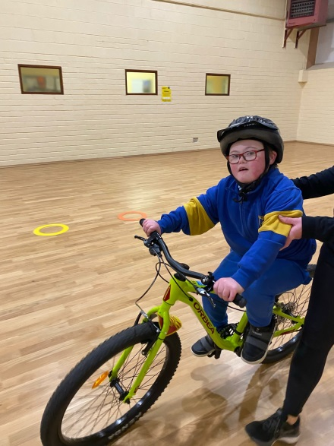
Action Area1-Diverse Opportunities
Cycling
Learn to Cycle for People with a Disability
  Trained 2 tutors to deliver the Cycle Right – Learn to Cycle for people with a disability programme in Wicklow
  Our 2 tutors have delivered to
    Newtownmountkennedy NS in June, September & October to 4 ASD Units
    Lacken NS in November and December to 2 ASD
    Our target for 2022 is to deliver to another 6 ASD units up to June 2022.
Community Learn to Cycle Programmes have run in
  Wicklow Town,
  Greystones. in collaboration with Triple A
  Blessington with the support of the Blessington Access Group.
    We’ve had 27 participants through the community programme in 2021.
While the younger groups in both school and community have not all learned to cycle, overall the number of children cycling as a result of the intervention is about 66% success.
Tandem Pilot Training – Our tutor has also completed the Vision Sport Tandem Pilot Training, so the opportunity to include people with a vision impairment is now an option for our Cycling programmes.

Slide 16
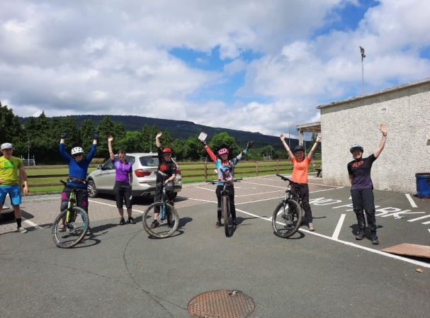
Action Area1-Diverse Opportunities
Cycling
Women’s MTB Courses
  2 X 2 day mountain bike courses.
  This course was aimed at women who are new to riding who want to learn the basics skills and feel safe and in control on the trails. The course will help riders to build a foundation of skills helping them gain confidence and stability whilst on the trails.
  The courses took place in;
    Carrick Mountain, Glenealy
    12 women taking part (sold out).

Slide 17
Action Area1-Diverse Opportunities
Men's-Fit Camp
  This was a campaign run by Sport Ireland in January targeting men 30+. For the campaign we ran a 6 week online Strength & Conditioning programme. HD Fitness delivered the programme and 12 men took part.
Stretch & Mobility
  A free 8 week online programme aimed at older adults & delivered by a Siel Bleu instructor.
  Started 15th March. 24 participants took part.
  10 week Stretch & Mobility Programme running the Pastoral Hall in Wicklow Town with 8 people taking part.
Get Active Programme
  A four week programme with St. Kevin’s Community School Dunlavin. 20 Leaving Cert Applied students took part – HD Fitness delivered this face to face (boxercise, Pilates, HIIT & bootcamp).
Open Sea Swimming Programme with Swim Ireland
  Bray, Wicklow Harbour & Arklow.
  Beach to Buoy – beginners (need to be able to swim 50m), eight week programme.
  Open Water Skills – (If you can swim 700m in open water), eight week programme.
  Intensive Open Water Week for Teens – 5 day programme aimed at teens new to sea swimming, 45 mins per day.
Mental Health Exercise Programme
  12 weeks in Newcastle Hospital, started 16th July – targeting young men and women who are in – patients - (funding carried over from last year and replacing some of the Woodlands for Health budget)
Pregnancy Yoga with Jo
  A four week programme.
Traveller Women Dance Fit programme
  6 week programme. with 12 women attending.
Intro to Chair Yoga, Arklow Sports Hub (outdoors)
  A 6 week programme. Started 16th June. 8 people attended this programmetarted 17th May – 15 mums took part in this programme and feedback was very positive.

Slide 18
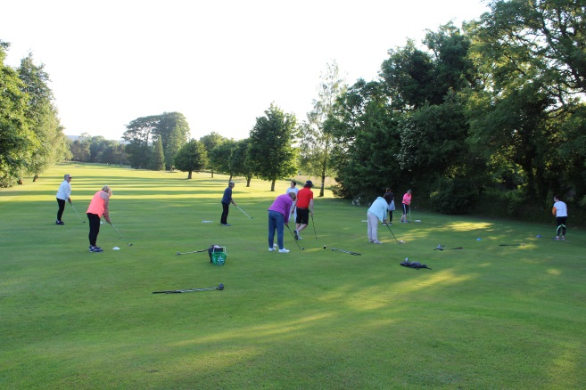
Action Area1-Diverse Opportunities
Shed to Summit
  Shed to Summit, Blessington Women’s Shed - Two, Five week mountaineering programmes delivered by a qualified Mountaineering Ireland leader who guide’s participants on the walk and passes on some key points of information.
  The programme was divided into three half days and two full day experiences. A total of 12 participants took part and were provided with skills to practice navigation and continue to hill walk independently.
Women Get into Golf Programme
  This was an eight week intro to golf programme taking place in Blessington Lakes Golf Club once a week. 24 women took part in this programme and on completion received a reduced yearly membership rate for the club.
  The programme was delivered by Pro Golfer Tom O’Neil.
Zero – Hero Programme
  An eight week Zero – Hero Programme. This programme was aimed at ‘absolute beginners to exercise’. It was held in Kickfit Fitness Centre in Wicklow Town with seven people taking part.

Slide 19
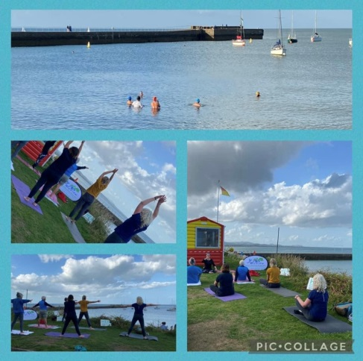
Action Area1-Diverse Opportunities
Signature Community Events
#HerOutdoorsWeek – 13th – 15th August
  Women’s Virtual 3K Run – Ran over three days during the #HEROutdoorsWeek. 500 women took part in the run and on completion, were sent out a ‘Women’s Virtual 3K’ medal and a Wicklow SRP face mask.
  Women’s Gearing Up Off Road – Two GUOR Programme were delivered over the #HEROutdoorsWeek. Taking place in Carrick Mountain, Glenealy. 16 women took part in this programme. Women’s Intro to Sailing – Took place in Wicklow Sailing Club in partnership with Sailing Ireland. 16 women took part.
  Yoga & Dip in Wicklow Harbour in partnership
  with Swimming Ireland- 14 women took part

Slide 20
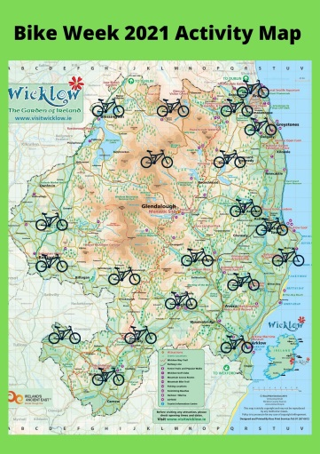
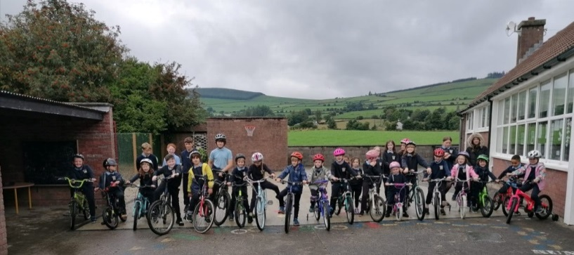
Action Area1-Diverse Opportunities
Signature Community Events
Bike Week 18th – 26th September 2021
  This year’s Bike Week was a huge success which saw sixteen fun– filled events across Wicklow with over 1500 people taking part and catering for all age groups and abilities. Wicklow Sports and Recreation Partnership organised a number of community events along with engaging with a wide range of schools and organisations. Bike Week Funding.
  22 Schools took part
  25K Pedal for your Medal, Countywide –
  78 completed receiving a Bike Week medal
  and Wicklow SRP face mask
  Family Cycle, Wicklow Town
  Six Cycle to Zen, The Avon Blessington
  Three Bike Maintenance Workshops
  (beginners and advanced), The Sports Room
  Wicklow Town & The Avon Blessington.
  Three Bike, Body, Calm, The Abbey Grounds,

Slide 21
Action Area1-Diverse Opportunities
Signature Community Events
European Week of Sport
  EWOS took place 23rd – 30th September.
  3 Events;
    Pound Fit Class took place Saturday 25th September in Burnaby Park Greystones at 10am,
    2 Swim Ireland Open Sea Swim Events, took place in Wicklow Harbour and Bray
    2 Hiking Festivals took place Sunday 26th in partnership with Mountaineering Ireland.

Slide 22
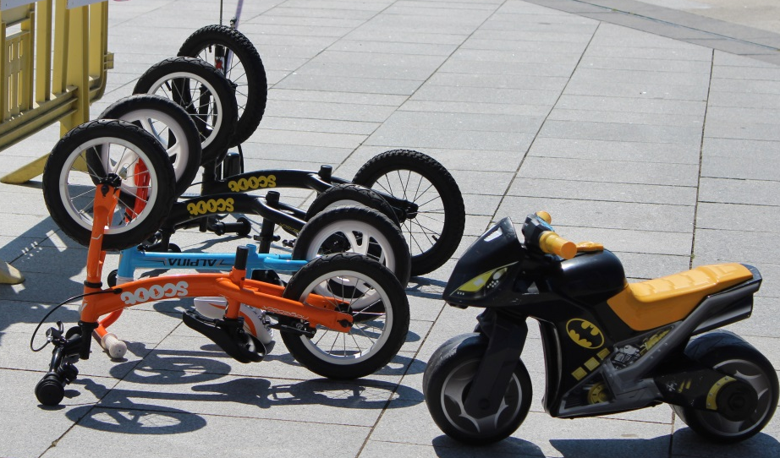
Action Area 2
Good Places, Great People
Action Area 2 – Good Places and Great People
  Advocate for, encourage and actively support those who develop, improve and manage recreational sports & physical activity facilities
  Provide, organise and support training and education opportunities.
  Encourage and support educators
  to instil the value and provide the
  opportunity of sports and physical
  activity

Slide 23
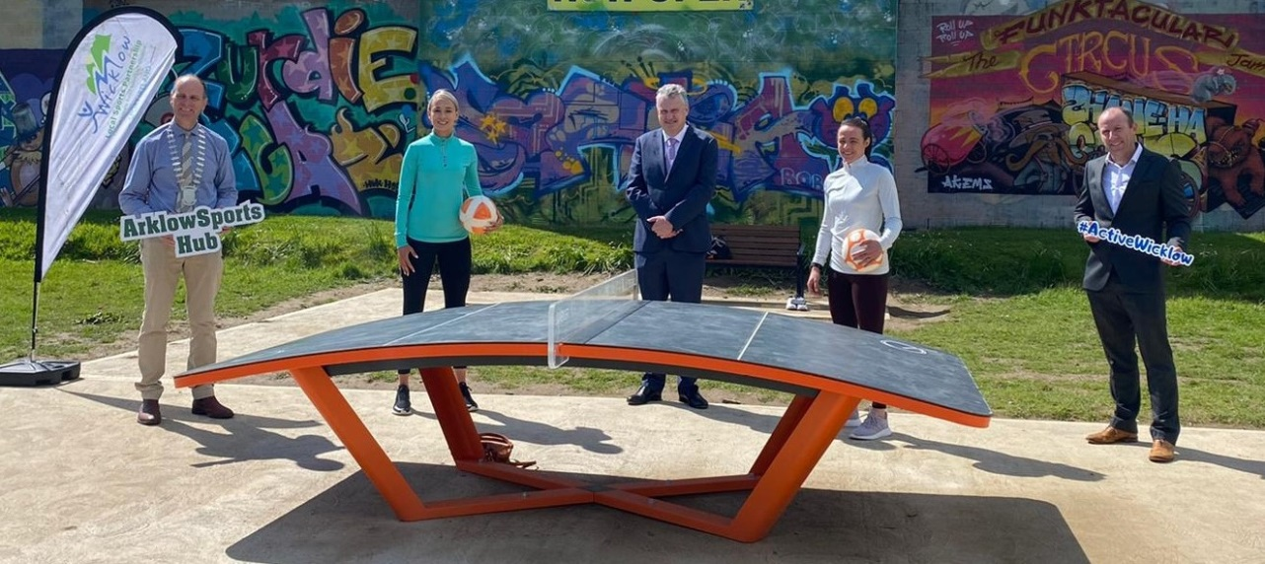
Action Area 2
Good Places, Great People
Dormant Account Funding via Sport Ireland
  Community Sports Hubs include capital funding for equipment and refurbishment
    WSRP currently have a Hub in Arklow and an application submitted for Rathdrum
  Urban Outdoor Recreation Initiative application submitted in conjunction with Wicklow Travellers Group which includes capital investment.

Slide 24
Action Area 2
Good Places, Great People
Coordination of Sports Capital applications within WCC by WSRP
COVID 19 Supports distributed to clubs to enable venues to facilitate getting back to activity
Representation and audit provision by WSRP Sports Inclusion Development Officer, Glendalough assessment underway
Input into facilities audits completed by WCC
Training & Education
  Sport Leader UK Course
    October in Scoil Chonglais, Baltinglass with 45 transition year students taking part.
  TY Outdoor Recreation Course ongoing and growing

Slide 25
Action Area 2
Good Places, Great People
Training & Education;
Course | Date | Participants
Sports Inclusion Disability Awareness | 15th March | 30 (fully booked)
Autism in Sport | 30th March | 20 (fully booked)
Sports Inclusion Disability Awareness | 6th April | 19
Inclusive Fitness Training | 19th April | 13
Sports Inclusion Disability Awareness | 26th April | 14
Autism in Sport | 10th May | 11
Sports Inclusion Disability Awareness | 17th May | 6 - teacher based programme
Inclusive Fitness Training | 24th May | 13
Safeguarding | Date of Course | No of Participants |  | Safeguarding | Date of Course | No of Participants
SG1 | 03/02/2021 | 10 |  | SG1 | 04/05/2021 | 6
SG2 | 10/02/2021 | 10 |  | SG1 | 08/05/2021 | 11
LGFA SG1 | 19/02/2021 | 12 |  | SG1 | 11/05/2021 | 10
LGFA SG1 | 26/02/2021 | 11 |  | SG1 | 25/05/2021 | 11
SG1 | 09/03/2021 | 9 |  | SG2 | 17/06/2021 | 8
SG1 | 10/03/2021 | 12 |  | SG1 | 15/07/2021 | 9
SG1 | 10/03/2021 | 10 |  | SG3 | 27/07/2021 | 12
SG1 | 12/03/2021 | 8 |  | SG1 | 17/08/2021 | 10
SG1 LGFA | 18/03/2021 | 11 |  | SG2 | 23/09/2021 | 6
SG1 | 19/03/2021 | 8 |  | SG1 | 28/09/2021 | 9
SG1 | 24/03/2021 | 10 |  | SG1 | 22/10/2021 | 11
SG1 | 12/04/2021 | 10 |  | SG1 | 19/11/2021 | 12

Slide 26
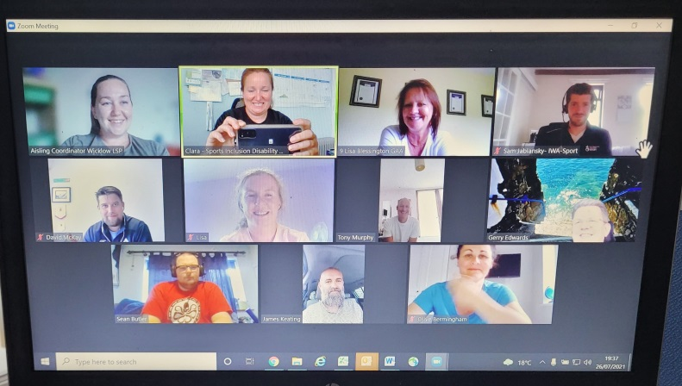
Action Area 2
Good Places, Great People
Sport Ability Forum
  IWA-Sport,
  Lakers Bray,
  Blessington GAA,
  Blue Dolphins,
  Kilcoole GAA,
  Baltinglass Basketball Bulldogs
  The first meeting was held via zoom on Monday 26th July at 7pm.
  There are many potential benefits for this group and for Wicklow Sports & Recreation Partnership for the future, including but not limited to;
    Sports Ability Day, to showcase inclusive sports and physical activity in our County
    Network of support for new emerging inclusive clubs, sharing of knowledge
    Focused funding for the needs of this community

Slide 27
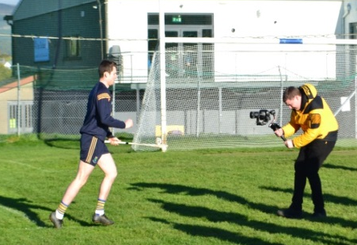
Action Area 2
Irish Deaf Society, WSRP, GAA, LGFA, Camogie Pilot signing project
Pilot Project
  An Tochar GAA, Irish Deaf Society, WSRP & GAA Health &
  Wellbeing Committee with support from Inclusion officers of
  GAA, LGFA & Camogie.
  This project has progressed steadily throughout 2021.
  And on 20th November filming took place at An Tochar GAA.
  The outcome will be a video of County Wicklow GAA stars demonstrating GAA skills, like “solo”, “kick”, “ball”, “yellow card”… etc. 10 skills demonstrated and up to 30 commonly used terms in GAA then signed by presenters in Irish Sign Language (ISL).
  Rita Brady of An Tochar GAA has been a driving force for this project. Rita and other members of the GAA Health & Wellbeing committee and Clara Jenkinson of WSRP are the presenters in ISL of the GAA skills while other local ISL users present the commonly used words.
  The project will hopefully be launched in early 2022 at the start of the GAA season.

Slide 28
Action Area 3
Research & Communications
Action Area 3 – Research and Communications
  Capture & analyse participation data from our programmes
  Highlight the insights from our Research and the Research of others
  Devise an annual communication plan that will increase awareness of available activities, promote those who provide participation opportunities and raise the visibility and awareness of the WSRP
  Develop partnerships with stakeholders in Ireland and Europe where appropriate

Slide 29
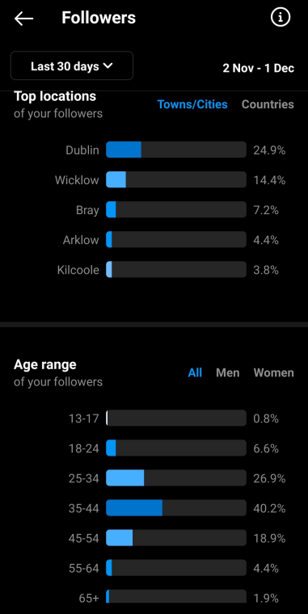
Action Area 3
Research & Communications
Wicklow Sports & Recreation partnership continues to use the ‘M1’ validated data collection question from Sport Ireland on all relevant programmes.
  This includes a survey at the start of the programme, at the end and a follow up contact 3 months after the programme.
  This information takes into account the Age, Gender, Location and Physical activity level of all participants and allows WSRP to analyse if we are targeting our programmes correctly.
WSRP continues to collect information as part of our Operational Plan including;
  Action areas as relevant to our Strategic plan
  Gender
  Age
  Disability
  Ethnicity
Social Media details;
  Facebook
    3,572 Followers
    In the last 28 days there were 12.3K post reaches and 2.4K engagements
  Instagram
    1,495 Followers
Recruitment for a Strategic Promotions Officer in 2022

Slide 30
Action Area 3
Research & Communications
Wicklow Sports & Recreation partnership are represented on numerous committees and steering groups by the staff, namely;
  Wicklow Children & Young Peoples Services Committee (CYPSC), Physical Health and West Wicklow Sub group
  Wicklow Outdoor Recreation Committee
  Community, Culture & Social Development (CCSD) Strategic Policy Committee (SPC) of Wicklow County Council
  Sport Ireland LSP Coordinators network
  LCDC Healthy Ireland Sub Group
  National Disability Sports working group
  CARA Healthy Me
  Wicklow County Council Disability Inclusion Steering Committee (DISC)
  Lucena Youth Activity Project
  Tusla ASD Teen Project
  County Wicklow Sports Ability Forum
  Wicklow GAA Health & Wellbeing Committee (Advisory Role)
  Local Authority Play & Recreation Network
  Sport Ireland Women in Sport Sub group
  Wicklow County Council Communications Group

Slide 31
Action Area 4
Standards & Resources
Action Area 4 – Standards and Resources
  Support sports and physical activity organisations to adhere to proper governance, safety and administration standards within their area of expertise.
  Be transparent in what we do and how we do it by operating high levels of governance and by adhering to formal operating procedures across all areas of responsibility
  Pursue the use of available resources as effectively as possible

Slide 32
Action Area 4
Standards & Resources
Funding 2021
Wicklow Sports & Recreation Partnership received the following;
  €323,883 of CORE Funding from Sport Ireland
  €16,167.48 from the Department of Transport, HSE and the Department of Youth Affairs
  €79,025 in Dormant Account funding from Sport Ireland
  €48,298 in Healthy Ireland funding over a period of 2 years
Grants
  €37,120 of Club development grants of were distributed in 2021
  €51,528.87 of COVID Related supports were distributed to clubs and community groups
Funding partners;
  Sport Ireland CORE
  Sport Ireland Dormant Account
  Healthy Ireland
  Department of Transport
  Department of Health
  Wicklow County Council

Slide 33
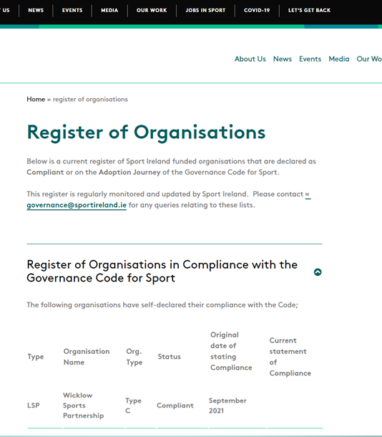
Action Area 4
Standards & Resources
Wicklow Sports & Recreation Partnership registered as Compliant with the Sport Ireland Governance Code in September 2021.
This exercise resulted in a huge amount of time and expertise invested by the members of both the sub committee and main WSRP committee.
A total of 120 hours were invested by the committee, including 8 sub committee meetings.

Slide 34
Strategic Plan 2020 - 2023
‘More people enjoying taking part’
Encouraging fun in Sports and Physical activities
Inspire participation amongst the less active
Supporting providers of sports and physical activities

